Slide 1
DS Capstone Project
Video games sales analysis

Slide 2
Video Games Industry
Fun Business
10,000 games released in 2020 on Steam alone
Heavy investment, games with 50 million budget are not uncommon
In this project, explore factors to affect game sales by knowledge learned from this course

Slide 3
Data Preparation
Data from Kaggle
Data was merged by contributor with game sales data from VGCharts.com and Review Data from https://www.metacritic.com/
Data is not up to date, up to year 2016
Missing data on current gen consoles (PS5 and Xbox Series X/S)

Slide 4
Data Preparation
About 16000 row of data, but many missing info
Drop columns that is not important for game sale analysis
Covert Rating column
GTA 4 is the only Adult Only rating game, but sold extremely well. This will skew the data, set it to Mature rating, as this was what it rated when it released
Fill Null review score with mean value

Slide 5
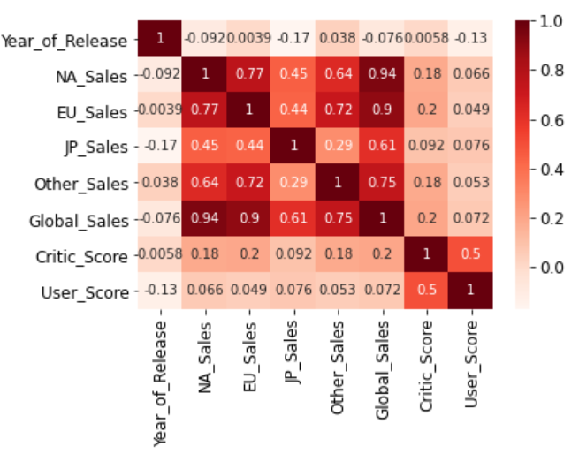
Analysis
Heat Map show that review score doesn’t affect sales much, but region sales have close relationship

Slide 6
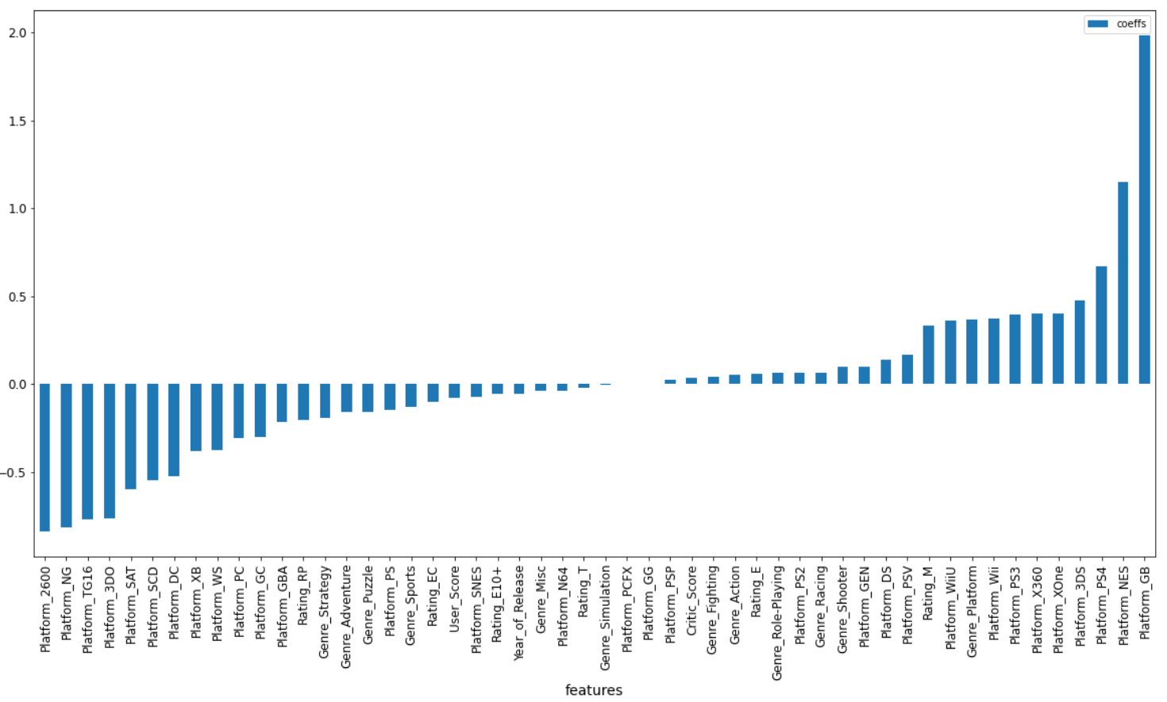
Process – Important feature affect sales

Slide 7
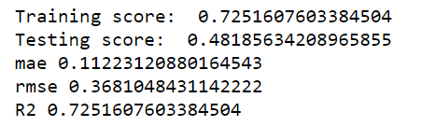
Model Predict Sale from NA to EU/JP/Others
Linear Regression
Factorized category feature
Split train test data
NA to EU model:

Slide 8
App – Predict Euro Sales from NA sales by Platform and Genre
https://tian-final-project-2021.herokuapp.com/

Slide 9
Thank You!

